Slide 1
WEB PROGRAMMING TRANING
BY
A.D. Adekale, Ja’afar Sadiq, Muhammed B. Ibrahim, Erasmus O. Edward

Slide 2
Day 2. HTML Fundamentals: HTML Elements and Structure

Slide 3
* What is HTML?
* HyperText Markup Language
* A markup language used to create web pages
* Consists of elements that define the structure and content of a web page

Slide 4
* Basic HTML Structure
* <!DOCTYPE html>
* <html>
* <head>
* <title>My First HTML Page</title>
* </head>
* <body>
* This is my first HTML page!
* </body>
* </html>

Slide 5
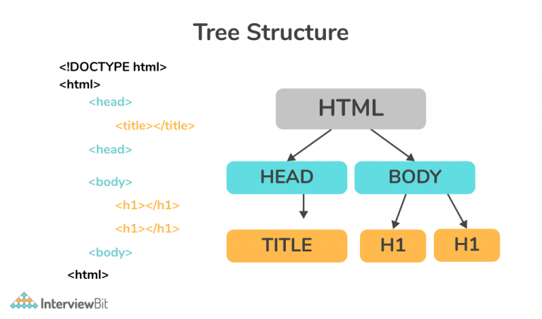

Slide 6
* HTML Elements
* Tags that define the structure of a web page
* Examples:
* `<h1>` for a heading
* `<p>` for a paragraph
* `<img>` for an image

Slide 7

* HTML Attributes
* Additional information about an HTML element
* Examples:
* `src` attribute for the source of an image or file location (where to find the image).
* `alt` attribute for an alternative text for an image

Slide 8
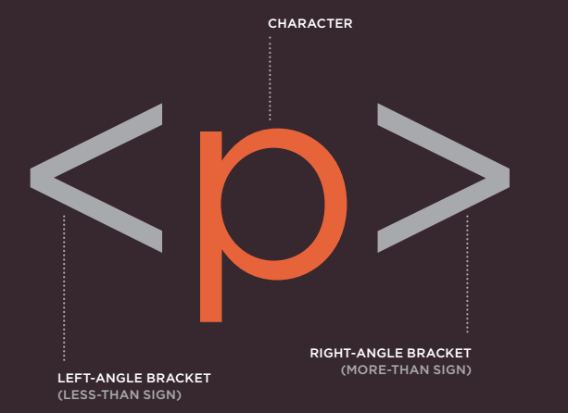
* Note
*All html tags must have opening and closing baraces

Slide 9
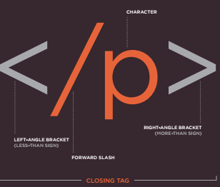
* Note
*All html tags must have opening and closing baraces

Slide 10
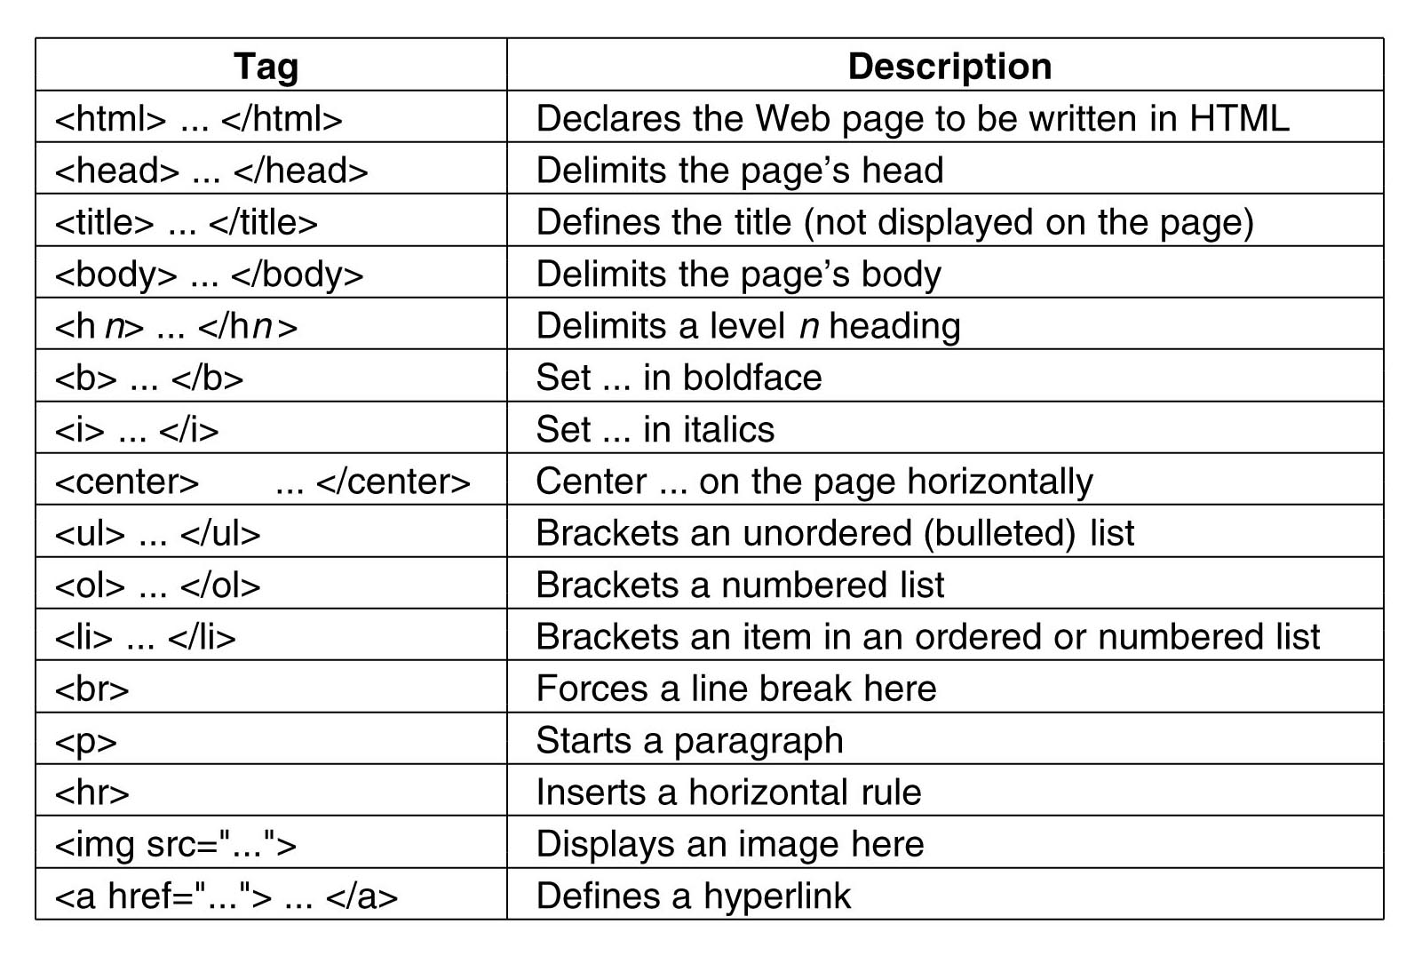

Slide 11
* How to Create an HTML Page
* Use a text editor to create a new file
* Save the file as `index.html`
* Enter the HTML code into the file
* Open the file in a web browser

Slide 12
* Conclusion
* HTML is a simple language that can be used to create web pages
* There are many resources available to help you learn HTML
* With a little practice, you can start creating your own web pages today!

Slide 13
* Resources for Learning HTML
* w3schools.com: https://www.w3schools.com/html/
* Mozilla Developer Network: https://developer.mozilla.org/en-US/docs/Web/HTML
* HTML Dog: https://htmldog.com/

Slide 14
THANK YOU.

